Slide 1
Artificial Neural Network
Aqsa Zahoor
Dept of Computer Science & IT
University of Sargodha

Slide 2
KOHONEN SELF ORGANIZING MAPS
Kohonen SOM have unsupervised training
The aim of Kohonen learning is to map similar input-vectors to similar neurone positions;
Neurones or nodes that are physically adjacent in the network encode patterns or inputs that are similar

Slide 3
KOHONEN SELF ORGANIZING MAPS
Architecture
neuron i
Kohonen layer
w_{i}
Winning neuron
Input vector X
X=[x₁,x₂,…x_{n}] ∈ R^{n}
w_{i}=[w_{i1},w_{i2},…,w_{in}] ∈ R^{n}

Slide 4
KOHONEN SELF ORGANIZING MAPS
Training of Weights
1) The weights are initialised to random values (between the interval -0.1 to 0.1, for instance) and the neighbourhood sizes set to cover over half of the network;
2) a m-dimensional input vector Xs enters the network;
3) The distances di(Wi, Xs) between all the weight vectors on the SOM and Xs are calculated by using (for instance):
where:
Wi denotes the ith weight vector;
wj and xj represent the jth elements of Wi and Xi respectively

Slide 5
KOHONEN SELF ORGANIZING MAPS
Training of Weights
4) Find the best matching neurone or “winning” neurone whose weight vector W_{k} is closest to the current input vector X_{i} ;
5) Modify the weights of the winning neurone and all the neurones in the neighbourhood N_{k} by applying:
W_{jnew} = W_{jold} + α(X_{i} - W_{jold})
Where α represents the learning rate;
6) Next input vector X_{(i+1)} , the process is repeated.

Slide 6
KOHONEN SELF ORGANIZING MAPS
Training of Weights
Linear
First neighbourhood
Second neighbourhood

Slide 7
KOHONEN SELF ORGANIZING MAPS
Training of Weights
Rectangular
First neighbourhood
Second neighbourhood

Slide 8
KOHONEN SELF ORGANIZING MAPS
Training of Weights
Why modify the weights of neighbourhood ?
We need to induce map formation by adapting regions according to the similarity between weights and input vectors;
We need to ensure that neighbourhoods are adjacent. Thus, a neighbourhood will represent a number of similar clusters or neurones;
By starting with a large neighbourhood we guarantee that a GLOBAL ordering takes place, otherwise there may be more than one region on the map encoding a given part of the input space.

Slide 9
KOHONEN SELF ORGANIZING MAPS
Training of Weights
One good strategy is to gradually reduce the size of the neighbourhood for each neurone to zero over a first part of the learning phase, during the formation of the map topography;
and then continue to modify only the weight vectors of the winning neurones to pick up the fine details of the input space

Slide 10
KOHONEN SELF ORGANIZING MAPS
Training of Weights
Why do we need to decrease the learning rate α ?
If the learning rate α is kept constant, it is possible for weight vectors to oscillate back and forth between two nearby positions;
Lowering α ensures that this does not occur and the network is stable.

Slide 11
KOHONEN SELF ORGANIZING MAPS
The weights
of the winner unit
are updated
together with the weights of
its neighborhoods

Slide 12
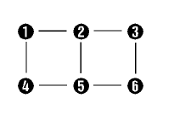
KOHONEN SELF ORGANIZING MAPS
Training of Weights
A rectangular grid of neurones representing a Kohonen map. Lines are used to link neighbour neurons.

Slide 13
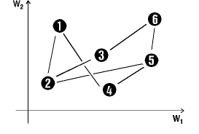
KOHONEN SELF ORGANIZING MAPS
Training of Weights
2-dimensional representation of random weight vectors. The lines are drawn to connect neurones which are physically adjacent.

Slide 14
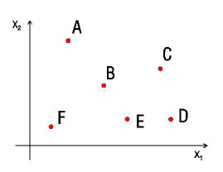
KOHONEN SELF ORGANIZING MAPS
Training of Weights
2-dimensional representation of 6 input vectors (a training data set)

Slide 15
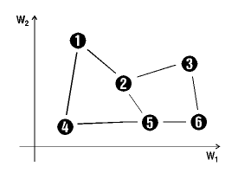
KOHONEN SELF ORGANIZING MAPS
Training of Weights
In a well trained (ordered) network the diagram in the weight space should have the same topology as that in physical space and will reflect the properties of the training data set.

Slide 16
KOHONEN SELF ORGANIZING MAPS
Training of Weights
Input space (training data set)
Weight vector representations after training

Slide 17
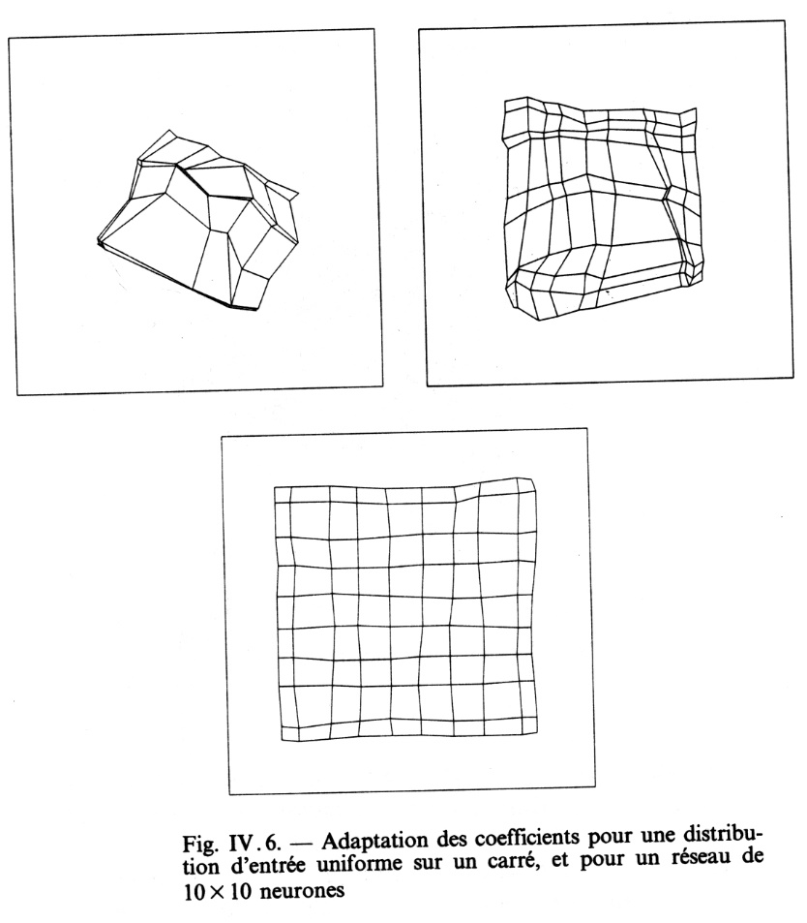
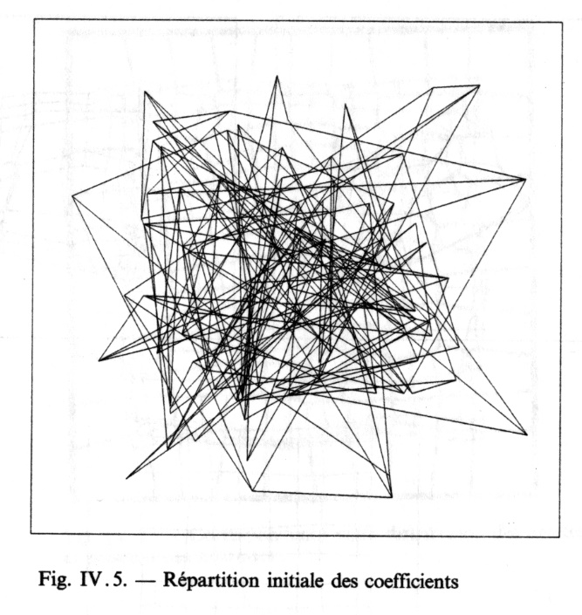
KOHONEN SELF ORGANIZING MAPS
Training of Weights
Inputs: coordinates (x,y) of points drawn from a square
Display neuron j at position x_{j},y_{j} where its s_{j} is maximum
100 inputs
200 inputs
y
From: les réseaux de neurones artificiels » by Blayo and Verleysen, Que sais-je 3042, ed PUF
x
1000 inputs
Random initial positions

Slide 18
KOHONEN SELF ORGANIZING MAPS
Classification of inputs
a) In a Kohonen network, each neurone is represented by a so-called weight vector;
b) During training these vectors are adjusted to match the input vectors in such a way that after training each of the weight vectors represents a certain class of input vectors;
c) If in the test phase a vector is presented as input, the weight vector which represents the class this input vector belongs to, is given as output, i.e. the neurone is activated.

Slide 19
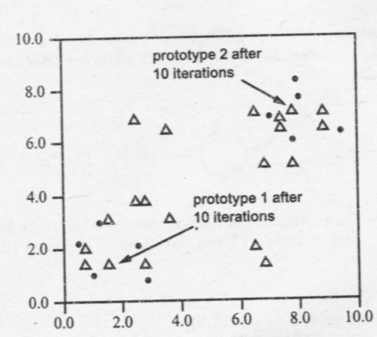
KOHONEN SELF ORGANIZING MAPS
Example
Two dimensional data covered by two neurons

Slide 20
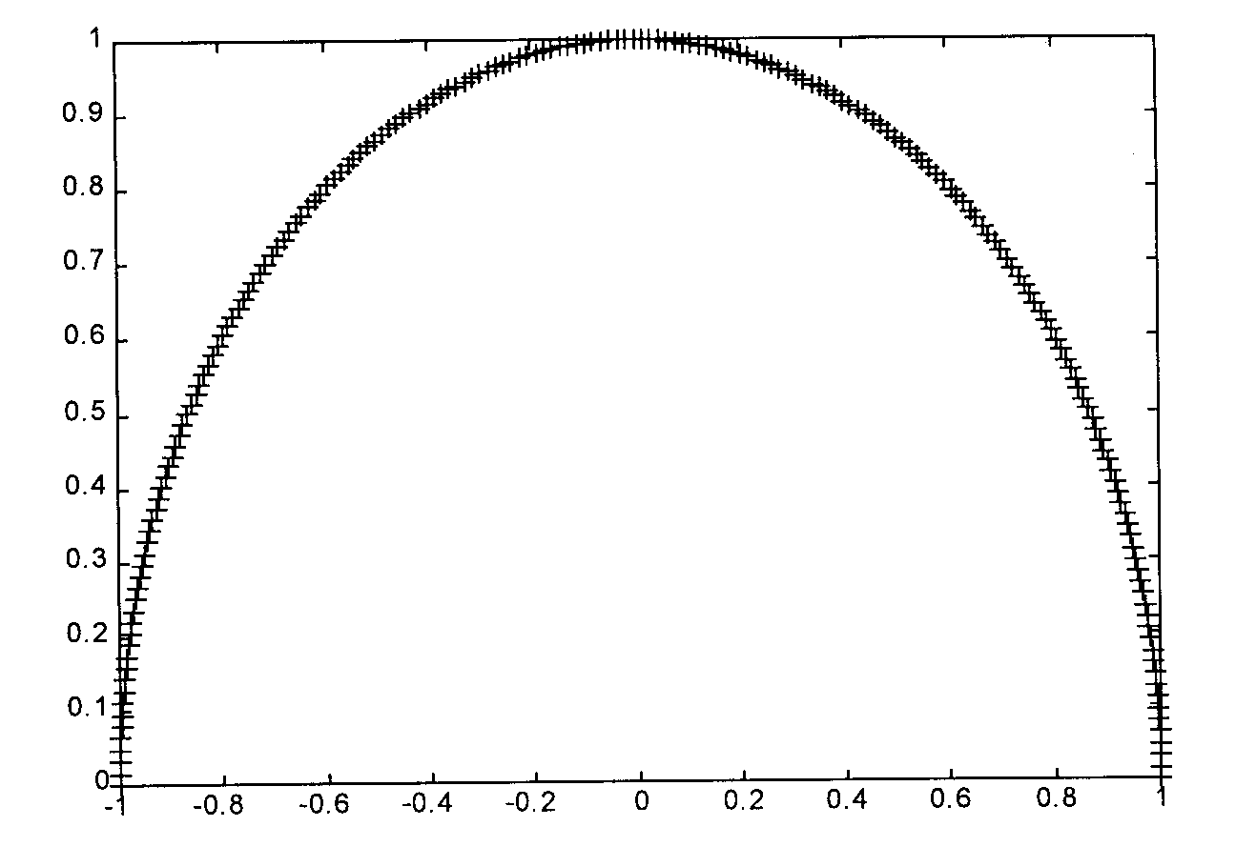
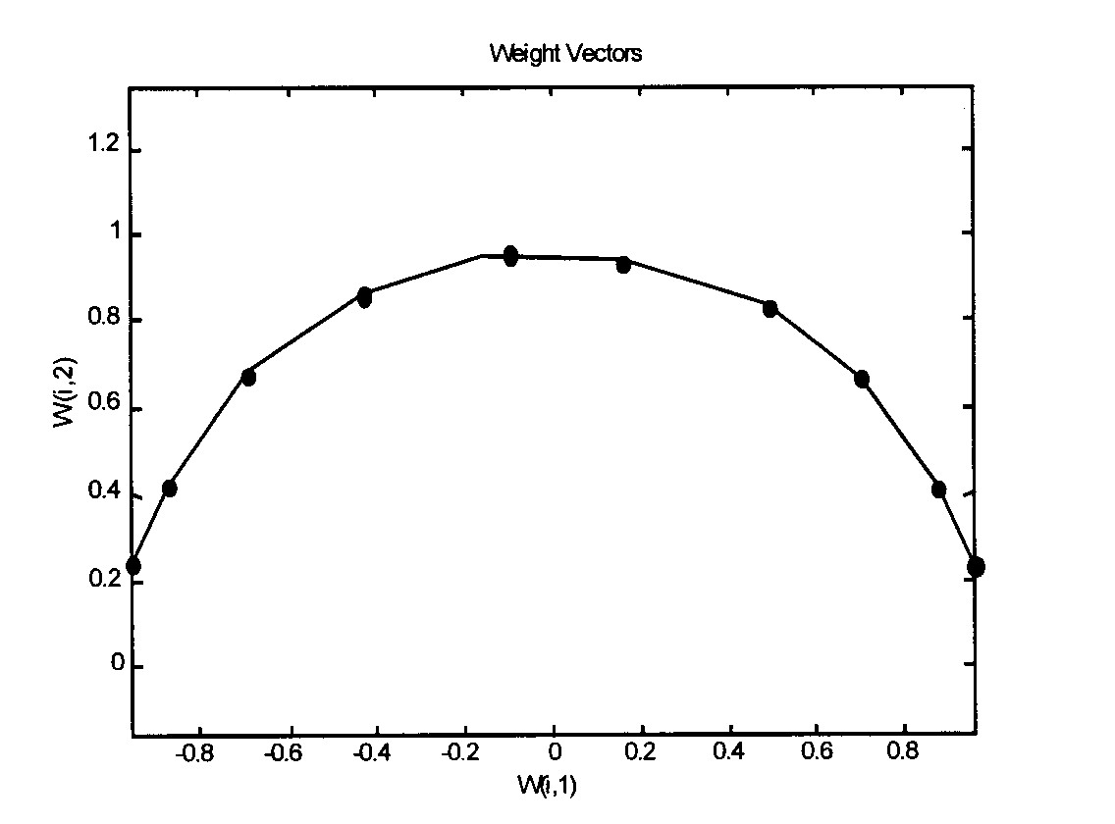
KOHONEN SELF ORGANIZING MAPS
Example
Two dimensional data covered by ten neurons

Slide 21
KOHONEN SELF ORGANIZING MAPS
Size of Neighborhood
In order to achieve good convergence for the above procedure, the learning rate α as well as the size of neighborhood N_{c} should be decreased gradually with each iteration
When the neighborhood around the winner unit is fairly large, a substantial portion of the network can learn each pattern
As the training proceeds, and the size of N_{c} decreases, fewer and fewer neurons learn with each iteration, and finally only the winner is adjusting its weights

Slide 22
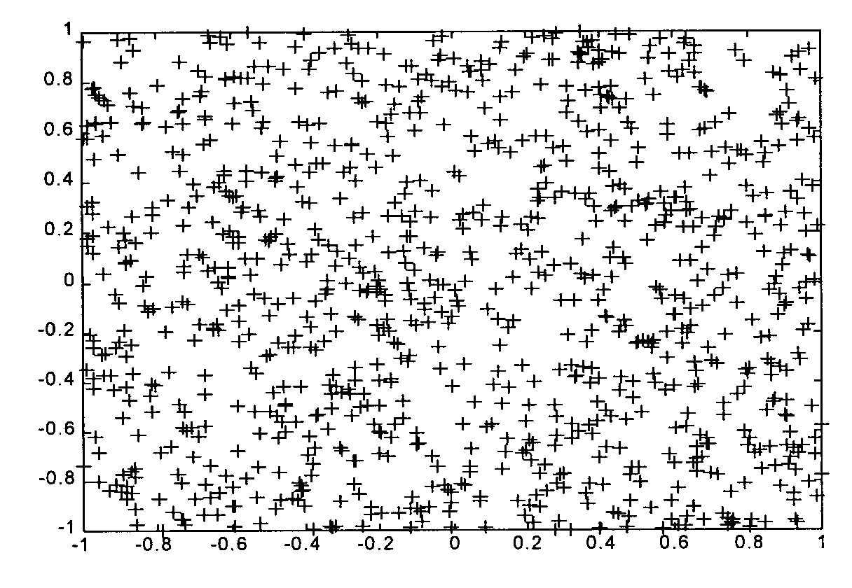
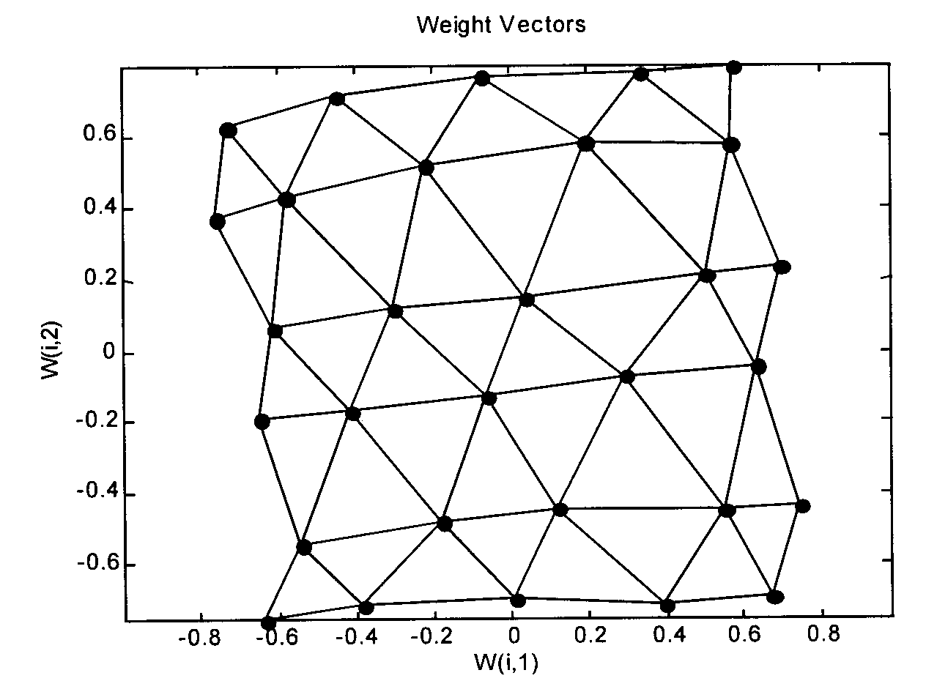
KOHONEN SELF ORGANIZING MAPS
Example
Two dimensional data
covered by 30 neurons

Slide 23
KOHONEN SELF ORGANIZING MAPS
Capabilities
Vector quantization
The weights of the winning neuron are a prototype of all the inputs vectors for which the neuron wins
Dimension reduction
The input to output mapping may be used for dimension reduction (less outputs then inputs)
Classification
The input to output mapping may be used for classification

Slide 24
KOHONEN SELF ORGANIZING MAPS
Example: Character Recognition
Cluster units available = 25
Input units = 9 x 7

Slide 25
KOHONEN SELF ORGANIZING MAPS
Example: Character Recognition

Slide 26
KOHONEN SELF ORGANIZING MAPS
Example: Character recognition

Slide 27
KOHONEN SELF ORGANIZING MAPS
Example: Character Recognition
No topological structure
(only winner neuron is allowed to learn)
The units not shown do not win for any input

Slide 28
KOHONEN SELF ORGANIZING MAPS
Example: Character Recognition
Linear topological structure
Winner neuron J is allowed to learn, along with X_{J+1} and X_{J-1} neurons

Slide 29
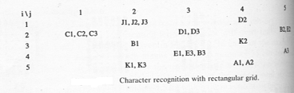
KOHONEN SELF ORGANIZING MAPS
Example: Character Recognition
Diamond shaped topological structure
Winner neuron is allowed to learn along with X_{I,J–1}, X_{I,J+1}, X_{I+1,J}, X_{I-1,J}

